Slide 1
SIEMENS
Function Block Diagram
© 2014 John Sefcovic

Slide 2
Function Block Diagram
Overview
Function Block Diagram programming uses instructions in a graphical format to connect the functions into procedures for the controlled application.
The instructions in Function Block Diagram programming are primarily used in event processes, analog process control, motion, and alarming.
Other programming instructions are included to allow the Function Block Diagram structures to be inclusive for the procedure being programmed.

Slide 3
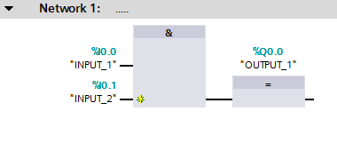
Function Block Diagram
Overview
A circuit is made up of Inputs and Outputs instructions which are assigned to PLC or Block Tags.
Function Block Instructions are connected to the Tags to read in data and write out data from the Function Block Instruction. The Function Block Instructions are arranged in Networks.
Connections are made by drawing lines between the “pins” on the instructions.

Slide 4
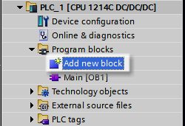
Function Block Diagram
New Function Block Routine
In the Project Tree, double left click on Add new block.

Slide 5
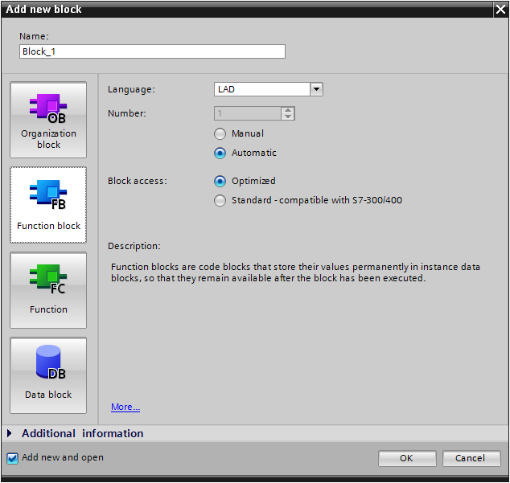
Function Block Diagram
New Function Block Routine
The Add new block dialog appears.
Select the type of Block to be added.

Slide 6

Function Block Diagram
New Function Block Routine
Type in the Name for the Block.

Slide 7
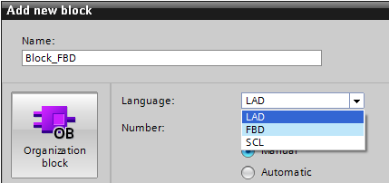
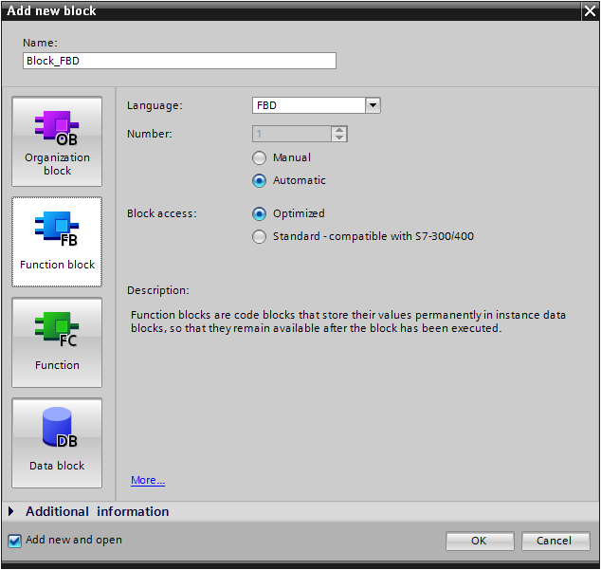
Function Block Diagram
New Function Block Routine
Select the dropdown for the Language type FBD.

Slide 8
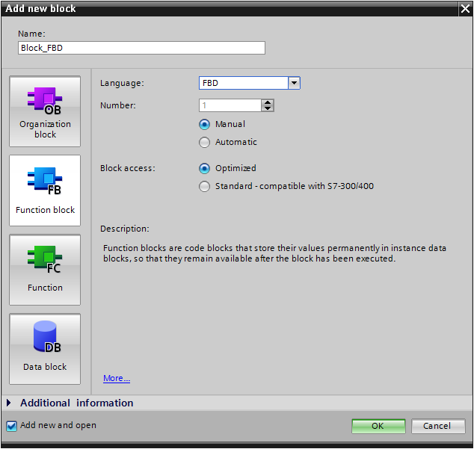
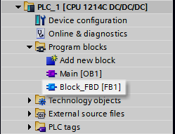
Function Block Diagram
New Function Block Routine
In the Project Tree, the New block is added.
Select the OK button.

Slide 9
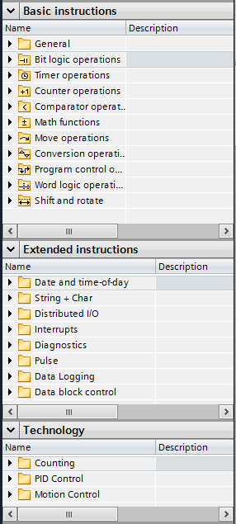
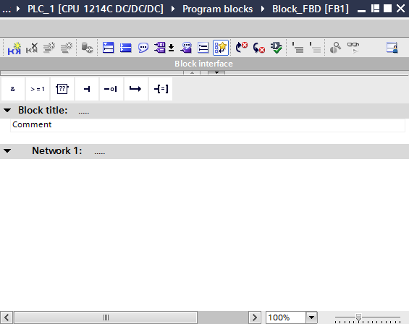

Function Block Diagram
Editor and Tool Bar
Instructions are dragged into the editor from the Favorites toolbar.
The blank editor screen.
Additional instruction may be selected from the folder listings.

Slide 10
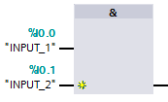
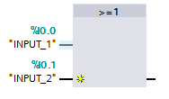

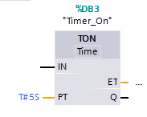
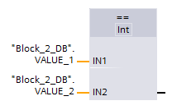
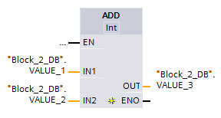
Function Block Diagram
Instructions
Various instruction function blocks can be selected to create the logic for the Function program.
AND
OR
ASSIGN
Click on star to get more inputs
Timer ON
EQUAL
ADD

Slide 11
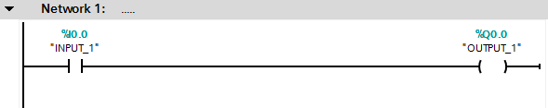
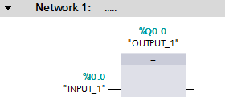
Function Block Diagram
Instructions
Normally Open with Output

Slide 12
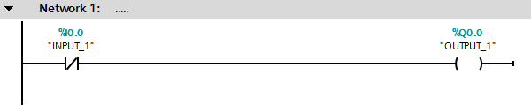
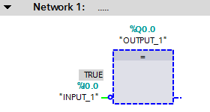
Function Block Diagram
Instructions
Normally Closed with Output
Circle for a not

Slide 13
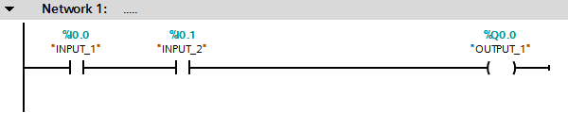
Function Block Diagram
Instructions
AND with Output

Slide 14
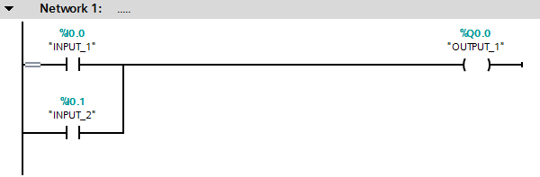

Function Block Diagram
Instructions
OR with Output

Slide 15
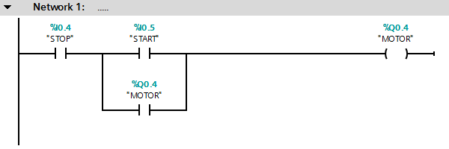
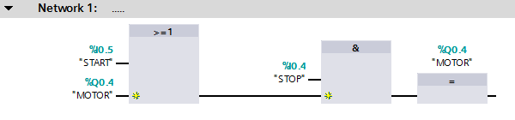
Function Block Diagram
Instructions
STOP - START with Output
no wrapping around

Slide 16
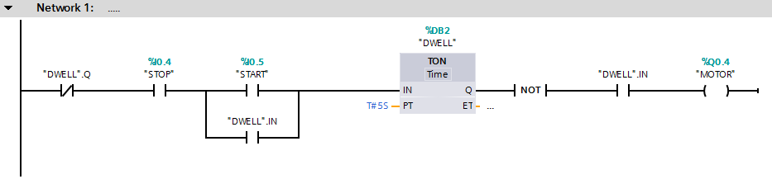
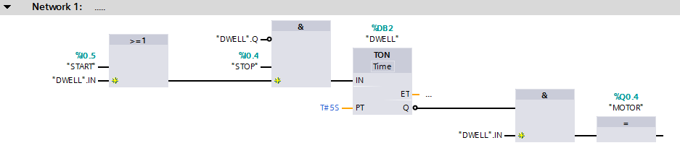
Function Block Diagram
Instructions
Example 1: TIMER ON with Output
not on outside also

Slide 17
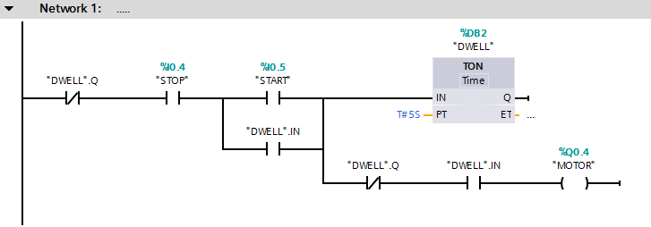
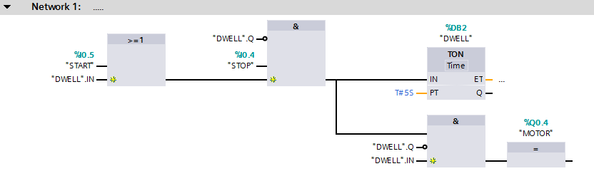
Function Block Diagram
Instructions
Example 1: TIMER ON with Output

Slide 18
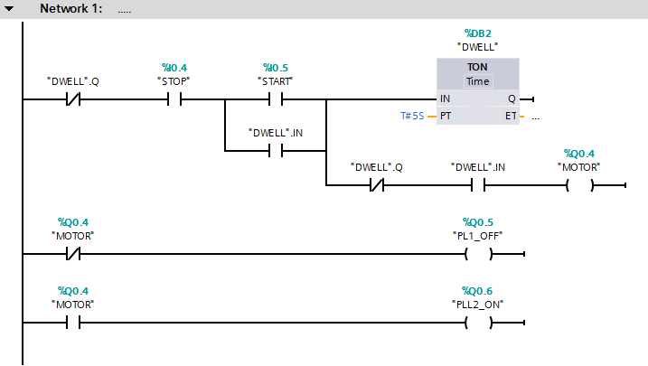
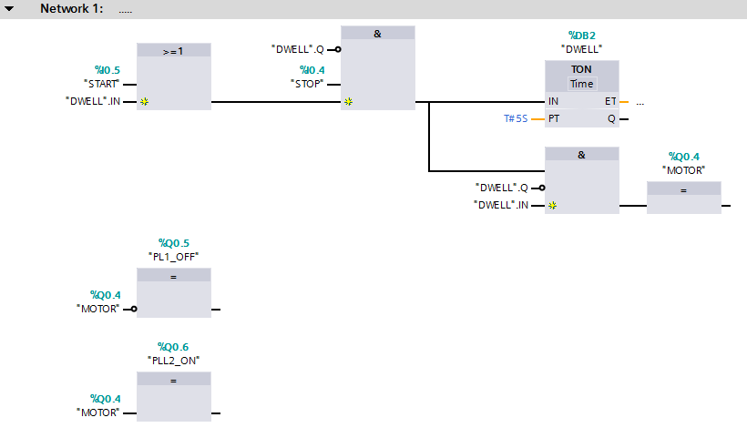
Function Block Diagram
Instructions
Example 3: TIMER ON with Output Indicators

Slide 19
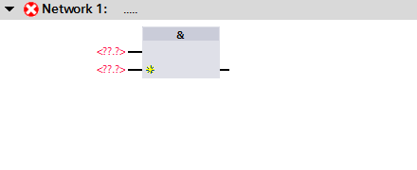
Function Block Diagram
Adding Instructions
In this example, AND instruction is dragged onto the editor.

Slide 20
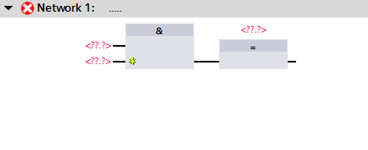
Function Block Diagram
Adding Instructions
The ASSIGN instruction is dragged onto the editor.

Slide 21
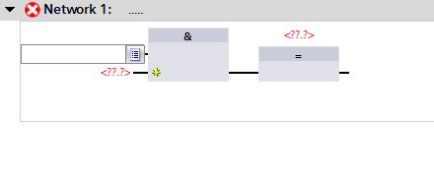
Function Block Diagram
Adding Tags
Double left click on the AND instruction’s first In question marks.

Slide 22
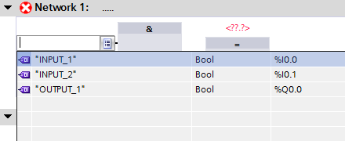
Function Block Diagram
Adding Tags
Select the Tag name from the dropdown list.

Slide 23
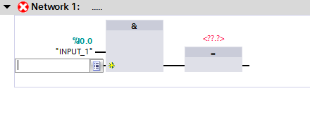
Function Block Diagram
Adding Tags
Double left click on the AND instruction’s second In question marks.

Slide 24
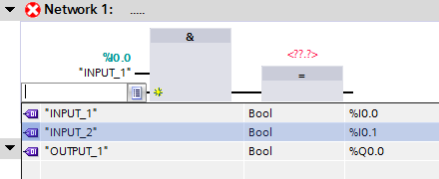
Function Block Diagram
Adding Tags
Select the Tag name from the dropdown list.

Slide 25
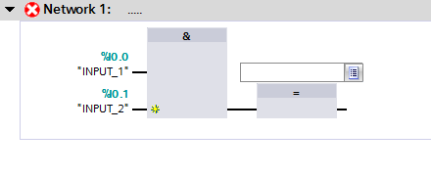
Function Block Diagram
Adding Tags
Double left click on the ASSIGN instruction’s question marks.

Slide 26
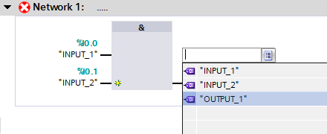
Function Block Diagram
Adding Tags
Select the Tag name from the dropdown list.

Slide 27
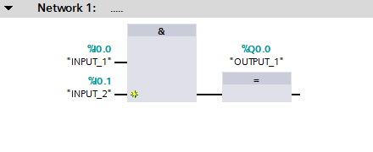
Function Block Diagram
Adding Instructions
Completed Network.

Slide 28
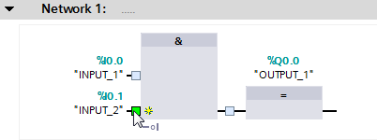
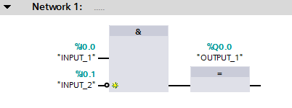
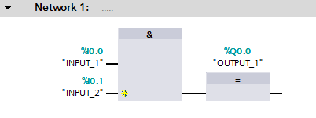

Function Block Diagram
Adding Instructions
Assigning the NOT to a pin.
The NOT instruction is dragged onto the editor.
The NOT can also be assigned to the “OUT” pin.
The pin changes to the NOT inverting the RLO.

